Slide 1
Immunisation Options in Endemic and Epidemic Conditions
Dr Isaac Golden
Australasian College of Hahnemannian Homeopathy

Slide 2
PURPOSE
To prevent suffering by protecting children and adults from potentially dangerous infectious diseases, using safe methods which will not of themselves cause either acute or chronic suffering

Slide 3
A. Vaccination provides a significant level of protection against some diseases, with low effectiveness against others, and lowered effectiveness when there are changes in the strains of circulating antigens of any disease. Its short-term safety has been quantified, but studies of long-term safety are incomplete.

Slide 4
A. Vaccination provides a significant level of protection against some diseases, with low effectiveness against others, and lowered effectiveness when there are changes in the strains of circulating antigens of any disease. Its short-term safety has been quantified, but studies of long-term safety are incomplete.
B. Homœoprophylaxis (HP) claims a similar level of effectiveness as vaccination with significantly less risk of short or long-term adverse events.

Slide 5
Eight Issues
1. Effectiveness of the method:
2. Storage and administration issues:
3. Flexibility during changing disease conditions:
4. Length of protection:
5. Short-term safety:
6. Long-term safety:
7. Direct costs:
8. Cost:Benefit Analysis:

Slide 6
1. Effectiveness of the method
Vaccine efficacy ranging from 40% to 99%
HP averages 90%
Evidence supporting HP will be discussed at length at the end of the presentation

Slide 7
2. Storage and administration issues
For most vaccines an effective cold chain is essential
The administration of injected vaccines requires properly trained doctors and nurses, and appropriate equipment and hygiene is crucial
HP: All that is required is sensible hygiene and knowledge of possible antidoting factors

Slide 8
3. Flexibility during changing disease conditions
The antigenic strain used in the current vaccine no longer matches the antigenic strain of the circulating disease
HP remedies are easily adapted to changing antigenic conditions

Slide 9
4. Length of Protection
Neither vaccination nor HP are able to offer guarantees of how long protection against a targeted disease will last

Slide 10
5. Short-term safety
Most vaccinations do not cause immediate dramatic reactions such as death or permanent brain injury, although these events do occasionally occur
HP medicines, no toxic reactions are possible. Therefore in the short term very few reactions occur and these are mild, self-limiting, and not a result of toxins in the remedy

Slide 11
6. Long-term safety
Published articles in orthodox journals do not show any substantial long-term trials where the following three data parameters have been met:
An holistic examination of recipients health:
An examination of fully vaccinated and fully unvaccinated cohorts:
Age-appropriate participants:
Thus it is not possible to make a genuinely scientific statement regarding the long-term safety of vaccination

Slide 12
The long-term safety of HP has been studied by Golden, and the results show that children using an appropriate HP program have a better level of general health as measured by a lower incidence of diseases such as asthma, eczema, year infections, allergies and behavioural problems

Slide 13
Safety: HP v’s vaccines
 |  | All Diagnoses |  | GP Diagnoses
Condition | Measurement | HP only | Vaccinat-ion only | HP only | Vaccinat-ion only
Asthma | Odds Ratio | 0.117 | 1.75 | 0.124 | 1.89
 | Chi Test P | 0.0004 | 0.0025 | 0.0006 | 0.0007
Eczema | Odds Ratio | 0.382 | 1.315 | 0.239 | 1.76
 | Chi Test P | 0.0146 | 0.121 | 0.0097 | 0.006
Ear/Hearing | Odds Ratio | 0.917 | 1.149 | 0.703 | 1.517
 | Chi Test P | 0.792 | 0.459 | 0.364 | 0.04
Allergies | Odds Ratio | 0.550 | 1.220 | 0.307 | 1.518
 | Chi Test P | 0.074 | 0.239 | 0.038 | 0.061
Behaviour | Odds Ratio | 0.446 | 0.869 | 0.541 | 0.784
 | Chi Test P | 0.170 | 0.593 | 0.055 | 0.613

Slide 14
7. Direct costs
The direct costs of vaccines are much greater (possibly 20 times) than the direct cost of HP remedies

Slide 15
8. Cost:Benefit Analysis
Examining just one of the individual diseases listed – asthma - figures show that in Australia in the 2000–01 financial year direct health expenditure on asthma was $693 million. This was 1.4% of total health expenditure in that year. The proportion of total health expenditure attributed to asthma care was highest among children; particularly boys aged 5–14 years, where it was 5.5% of annual health expenditure in that age group.

Slide 16
Per capita asthma expenditure was highest for children aged 0–4 years.
Asthma directly caused 385 deaths in 2007.
The Australian Burden of Disease Study estimated that asthma accounted for 64,523 disability adjusted life years (DALYs) in 1996. The estimated financial equivalent of the burden of disease due to asthma in 1996 was $4.3 billion. The DALYs had risen to around 66,000 in 2010.
If vaccination causes asthma rates to treble as some studies suggest, then the cost is significant.

Slide 17
Table : A comparison of options
 | Vaccination | Homoeoprophylaxis
BENEFITS
Effectiveness in preventing infectious disease | Varies between diseases: 40%-99% | Around 90% for all diseases
RISKS/COSTS
Short-term adverse events | Generally mild. Very occasionally fatal. Up to 30% of doses | Generally mild. Around 2% of doses
Long-term adverse events | Not adequately quantified | Minimal. Positive benefits demonstrated
Ability to adjust to changing antigens | Costly. 6-12 months | Inexpensive. 1-2 weeks

Slide 18
 | Vaccination | Homoeoprophylaxis
Direct and indirect $$ cost | Development cost high. Delivery cost moderate | Development cost low. Delivery cost low
Ease of storage and administration | Moderate | Moderate
Length of protection | Uncertain | Uncertain
Cost benefit analysis | Significant potential direct benefits. Significant potential direct costs. | Significant potential direct benefits. Low potential direct costs.

Slide 19
The Effectiveness of HP
Four types of evidence:
Historical
Short Term Epidemic
Long Term Endemic
Regional and National

Slide 20
1. Historical Evidence
Vaccination commenced in 1796
HP commenced in 1798
HP first used by the founder of Homeopathy
HP used by most of the masters of
Homeopathy since then

Slide 21
2. Short-term Efficacy of HP
65,826 children were given the homoeopathic preventative and 23,532 were unprotected. The nosode was shown to be 95% effective in the first outbreak, and 95% effective after 6 months and 91% effective after 12 months in the second outbreak.
Mroninski C, Adriano E, Mattos G (2001) Meningococcinum: Its protective effect against meningococcal disease. Homoeopathic Links Winter Vol 14(4); pp. 230-4.

Slide 22
Some Measures of the Effectiveness of Homœoprophylaxis
Year | Researcher | Length | Numbers | Effectiveness %
1907 | Eaton | < 1 year | 2,806 | 97.5
1950 | Taylor-Smith | < 1 year | 82 | 100.0
1963 | Gutman | 1 year | 385 | 86.0
1974 | Castro & Nogeira | 3 months | HP 18,000 Not 6,340 | 86.1
1987 | English | 2 years | 694 | 87.0 – 91.5
1987 | Fox | 5 years | 61 | 82.0 – 95.0
1998 | Mroninski et al | 6/12 months | HP 65,826 Not 23,539 | 95.0 - 91.0

Slide 23
3. Long-term effectiveness of HP
Data collection from 1986 to 2004 of children using a 5-year HP program.
The single figure measure of effectiveness was 87.6% 90.4% 93.2%
95% confidence limits
Golden I (2005) The Potential Value of Homœoprophylaxis in the Prevention of Infectious Diseases, and the Maintenance of Health in Recipients. Swinburne University Press, Melbourne.

Slide 24
MEASURE OF HP EFFICACY
VE = ARU – ARV x 100
ARU
VE = Vaccine Efficacy
ARU = Attack Rate Unvaccinated
ARV = Attack Rate Vaccinated
Disease | Attack Rate, Unvaccinated % | Attack Rate, HP % | Efficacy of HP %
Whooping Cough | 85.0 | 11.7 | 86.2
Measles Mumps | 90.0 70.0 | 9.0 5.9 | 90.0 91.6

Slide 25
Tests to Validate the Results Reporting the Efficacy of Long-Term HP
 | Test | Result
1 | The accountability rate (the % of those surveyed who responded) of the final 5-years’ data was calculated to ensure a significant level of accountability (>70%) and thus greater reliability of results. | >70% accountability of first year responses was achieved
2 | Non-respondents were surveyed to ensure that the questionnaires that were received gave responses that were reflective of the entire population. | Responses from non-respondents were consistent with respondent replies.
3 | Respondents who reported acquisition of a disease were surveyed to verify the accuracy of their initial report. | High level of accuracy of initial reports.

Slide 26
4 | Respondents who reported exposure to a disease were surveyed to verify the accuracy of their initial report. | High level of accuracy of initial reports.
5 | A more detailed statistical analysis of the data was undertaken to determine confidence limits for the figure for the efficacy of HP. | Confidence limits were: CI = 87.6% - 93.2% (P=0.05)
6 | The accuracy of the measurements of efficacy based on notifications of and exposure to diseases was tested by calculating the sensitivity and specificity of the data. | High levels of sensitivity (disease = 90.9%, exposure = 95.6%), and specificity (disease = 98.1%, exposure = 99.2%)
7 | A comparison with national disease attack rates was undertaken to provide an effective control group against which to compare results. | Weighted average national disease attack rate = 79%; HP associated with reduction in disease, P <0.01.

Slide 27
4.1 Recent Research Findings:
The Cuban Experience

Slide 28
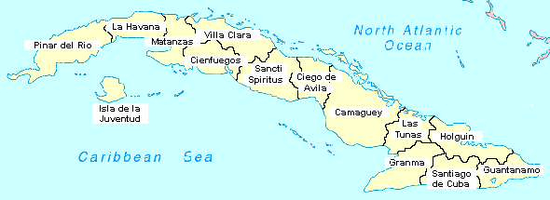
IR= Intervened region

Slide 29
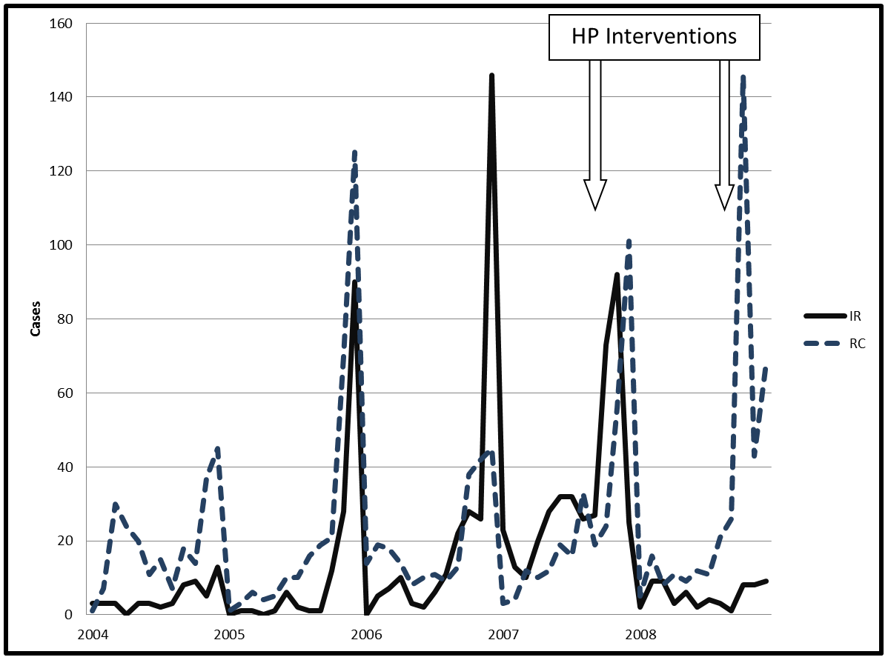
Leptospirosis Confirmed Monthly Cases in IR and RC from 2004 to 2008

Slide 30
Leptospirosis in IR and RC, 2004-2008, monthly totals, with the 2007 predictive IR data

Slide 31
2012 Research
Validation of Previous Analysis of the 2007 and 2008 Leptospirosis interventions involved:
Cleaning of existing raw data (weekly records of deaths and notifications)
Review of criticisms of Cuban report, especially and examination of the following possible confounding factors: vaccination, chemoprophylaxis, rainfall equivalence between 2004 and 2008, prevention awareness, use of a RCT.

Slide 32
Leptospirosis in 2007, actual and predicted incidence

Slide 33
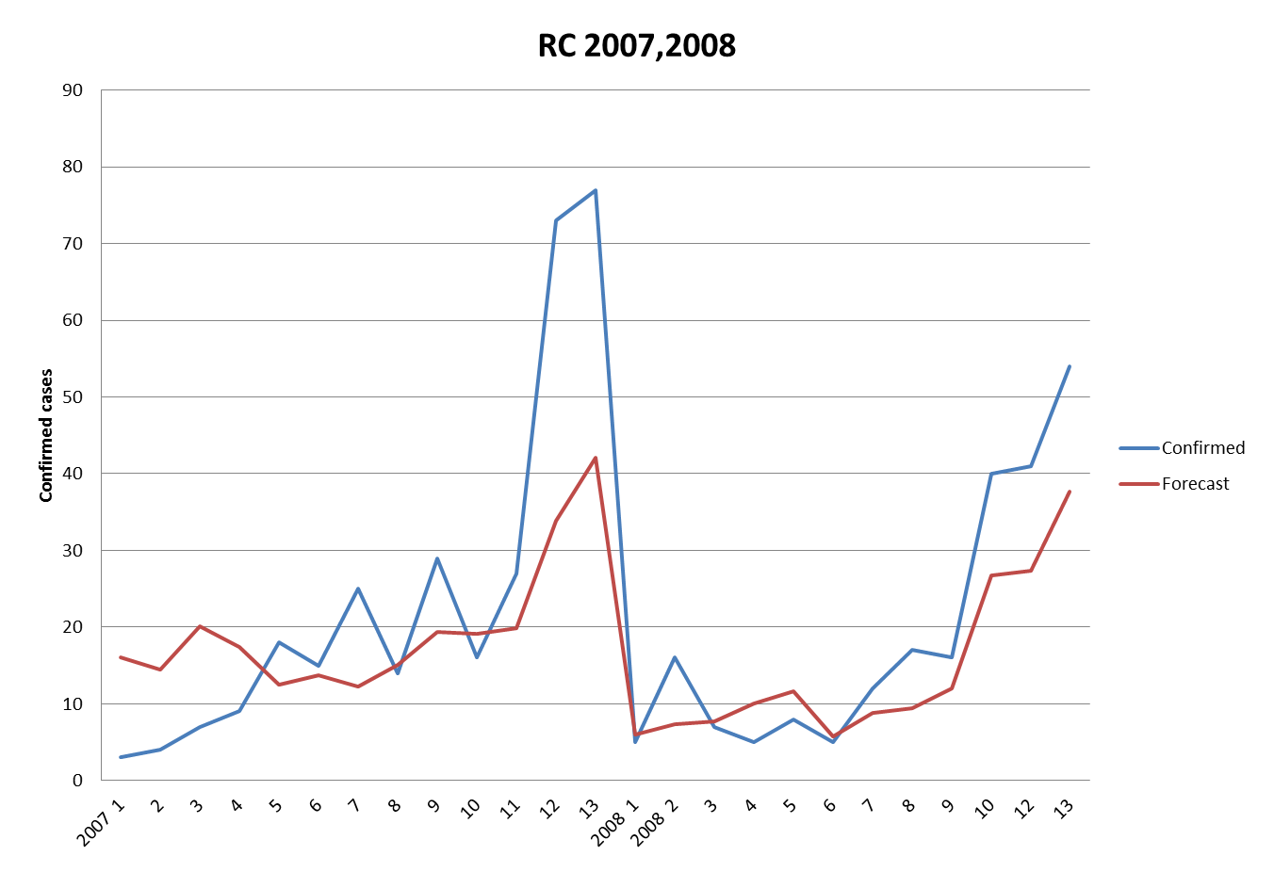

Slide 39
4.2 Recent Research Findings:
The Indian Experience

Slide 40
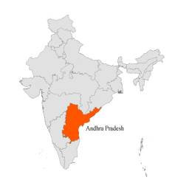

Slide 41
Method
The following prophylactic program was implemented:
Days 1, 2, 3: Belladonna 200
Day 10, Calc Carb 200
Day 25, Tuberculinum M
The remedies were administered in a phased manner to all children in the age group of 0 to 15 years in the month of August every year for three consecutive years. Symptom similarity, complimentary relationship, virulence and underlying Miasms were taken into consideration while selecting these drugs. This project was named as B.C.T.

Slide 42
Japanese Encephalitis Incidence in Andhra Pradesh 1991-2004
Year | Cases | Deaths
1991 | 528 | 213
1992 | 143 | 56
1993 | 1185 | 461
1994 | 261 | 10
1995 | 986 | 269
1996 | 332 | 108
1997 | 984 | 247
1998 | 524 | 192
1999 | 1036 | 203
2000 | 343 | 72
2001 | 33 | 4
2002 | 18 | 0
2003 | 0 | 0
2004 | 0 | 0

Slide 43
Japanese Encephalitis in 2001 in some states in India
State | Cases | Deaths | 2011 Pop. million | Cases/ mill (est.) | Cases/Deaths
West Bengal | 97 | 14 | 91.4 | 1.1 | 6.9
Uttar Pradesh | 625 | 132 | 199.6 | 3.1 | 4.7
Karnataka | 189 | 14 | 61.1 | 3.1 | 13.5
Haryana | 45 | 22 | 25.4 | 1.8 | 2.1
Bihar | 88 | 16 | 103.8 | 0.9 | 5.5
Assam | 241 | 113 | 31.2 | 7.7 | 2.1
Andhra Pradesh | 33 | 4 | 84.7 | 0.4 | 8.3

Slide 44
The Bottom Line
Are we “fair dinkum” about preventing targeted infectious diseases?

Slide 45
Dengue Fever
Sri Lanka Ministry of Health – Epidemiology Unit
Dengue Update 7/11/12: 36,981 suspected Dengue cases reported from January to November.
WHO stated there may be 50-100 million cases worldwide annually.
No vaccine currently available.

Slide 46
2012: GlaxoSmithKline fined $3 billion for illegal marketing of Paxil, Welbutrin and downplaying safety risks of Avandia
2012: Johnson & Johnson to pay over $1.5 billion for illegal marketing of Risperdal
2012: Abbott Laboratories fined $1.6 billion for aggressively promoting Depakote for off-label use in elderly dementia patients, despite lacking evidence of safety or effectiveness
2011: Merck to pay $950 million to resolve fraudulent marketing allegations related to Vioxx

Slide 47
2010: Allergan paid $600 million for strongly pushing Botox for unapproved uses
2010: AstraZeneca settled for $520 million for trying to persuade doctors to prescribe its psychotropic drug Seroquel for unapproved uses including Alzheimer's, ADHD, insomnia, and post-traumatic stress disorder
2009: Eli Lilly pays $1.4 billion for promoting Zyprexa for off-label uses, often to children and the elderly

Slide 48
2009: Pfizer fined $2.3 billion for marketing fraud related to Bextra, Lyrica and other drugs
2007: Bristol-Myers Squibb paid $515 million for illegally promoting its atypical antipsychotic drug Abilify to kids and seniors.
2007: Purdue Pharma paid $634.5 million for fraudulently misbranding Oxycontin, and suggesting it was less addictive and less abused than other painkillers.

Slide 49
2005: Serono (now Merck Serono) paid $704 million after pleading guilty to two felony charges for fraudulent marketing related to a growth hormone to treat wasting in HIV patients.
The U.S. Department of Justice reported recovering US $18,517,016,689 from October 1, 1987 to September 30, 2010 in 4,668 cases involving the Department of Health and Human Services as the primary client.

Slide 50
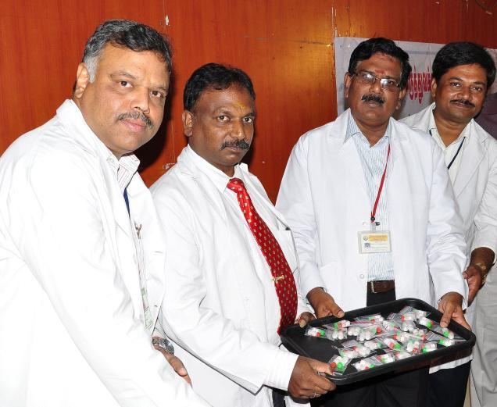
A. Gopalakrishnan (second from right), Principal in-charge, Government Homoeopathic Medical College and Hospital at Tirumangalam, handing over homoeopathy medicines for dengue fever prevention to A.Edwin Joe, Dean, Government Rajaji Hospital, at an awareness camp in Madurai on Thursday

Slide 51
Concluding Thoughts
Many public health systems have become disease management systems.
Many participants in public health systems are rewarded financially by high rates of chronic disease.
In most “developed” countries there are epidemics of chronic disease.

Slide 52
4. We must refocus on the promotion of health, not on the management of disease – we need a different model free of vested interests.
5. We must first do no harm.
6. We DO have gentle, inexpensive options for both the treatment and the prevention of disease, as well as for the promotion of health.
7. Our greatest need is TRUTH!

Slide 53
Contact
www.homstudy.net
admin@homstudy.net

Slide 55
The BMJ’s "Clinical Evidence" analyzed around 2,500 common medical treatments to evaluate which are supported by sufficient reliable evidence (BMJ, 2007):
13% were found to be beneficial
23% were likely to be beneficial
8% as likely to be harmful as beneficial
6% were unlikely to be beneficial
4% likely to be harmful or ineffective.
46% were unknown whether they were efficacious or harmful"

Slide 56
Corruption of the medical system by big pharma
Affects medical research
Affects medical education
Affects public perceptions
Affects political judgements
Big Pharma is dishonest, as shown by massive fines levied against many companies for corruption. For example

Slide 57
2012: GlaxoSmithKline fined $3 billion for illegal marketing of Paxil, Welbutrin and downplaying safety risks of Avandia
2012: Johnson & Johnson to pay over $1.5 billion for illegal marketing of Risperdal
2012: Abbott Laboratories fined $1.6 billion for aggressively promoting Depakote for off-label use in elderly dementia patients, despite lacking evidence of safety or effectiveness
2011: Merck to pay $950 million to resolve fraudulent marketing allegations related to Vioxx

Slide 58
2010: Allergan paid $600 million for strongly pushing Botox for unapproved uses
2010: AstraZeneca settled for $520 million for trying to persuade doctors to prescribe its psychotropic drug Seroquel for unapproved uses including Alzheimer's, ADHD, insomnia, and post-traumatic stress disorder
2009: Eli Lilly pays $1.4 billion for promoting Zyprexa for off-label uses, often to children and the elderly

Slide 59
2009: Pfizer fined $2.3 billion for marketing fraud related to Bextra, Lyrica and other drugs
2007: Bristol-Myers Squibb paid $515 million for illegally promoting its atypical antipsychotic drug Abilify to kids and seniors.
2007: Purdue Pharma paid $634.5 million for fraudulently misbranding Oxycontin, and suggesting it was less addictive and less abused than other painkillers.

Slide 60
2005: Serono (now Merck Serono) paid $704 million after pleading guilty to two felony charges for fraudulent marketing related to a growth hormone to treat wasting in HIV patients.
The U.S. Department of Justice reported recovering US $18,517,016,689 from October 1, 1987 to September 30, 2010 in 4,668 cases involving the Department of Health and Human Services as the primary client.

