Slide 1
Pharmacognostical identification of Sri Lankan endemic medicinal plant Curcuma albiflora Thwaites Wijayasiriwardena C., De Silva W.A.B.N., Premakumara G.A.S.
Dr. T.D.C.M.K. Wijayasiriwardena
[PhD in Pharmacognosy, Gujarat Ayurved University, India
Registered Traditional Medical Practitioner]
Senior Research Scientist
Herbal Technology Section
Industrial Technology Institute
Colombo 07
E.mail: drchandima@iti.lk
www.iti.lk
Industrial Technology Institute

Slide 2
Relevancy with Holistic medicine
Pharmacon = Drugs & Gignosy = To study
In Ayurveda Dravyaguna or study on various dravyas/substances(vegitable, animal & minaral) is well documented.
Pharmacognosy = Dravyaguna
Any medicinal preparation proper identity should be confirmed before employing for any medicinal uses.
Industrial Technology Institute

Slide 3
WHO guidelines
Industrial Technology Institute

Slide 4
Reason for selection
Curcuma albiflora Thwaites (Singhala: Haran-Kaha) of family Zingiberaceae is an endemic medicinal plant whose powdered rhizome is used in Sri Lankan Traditional Medicine.
No work has yet being carried out to establish its identity, quality and purity so far as its standardization is concerned.
Industrial Technology Institute

Slide 5
Objectives
To establish its identity by morphological, microscopical, physico-chemical, Thin Layer Chromatography and GCMS identification of hexane extract as per WHO guidelines on quality control and standardization of medicinal plant materials.
Industrial Technology Institute

Slide 6
Material & Methods
Curcuma albiflora plant was identified from Kalutara,Galle & Matara districts and 2 specimens from each district were collected, authenticated by National Herbarium, Peradeniya.
All the specimens pooled together and used for the present study.
Industrial Technology Institute

Slide 7
Industrial Technology Institute

Slide 8
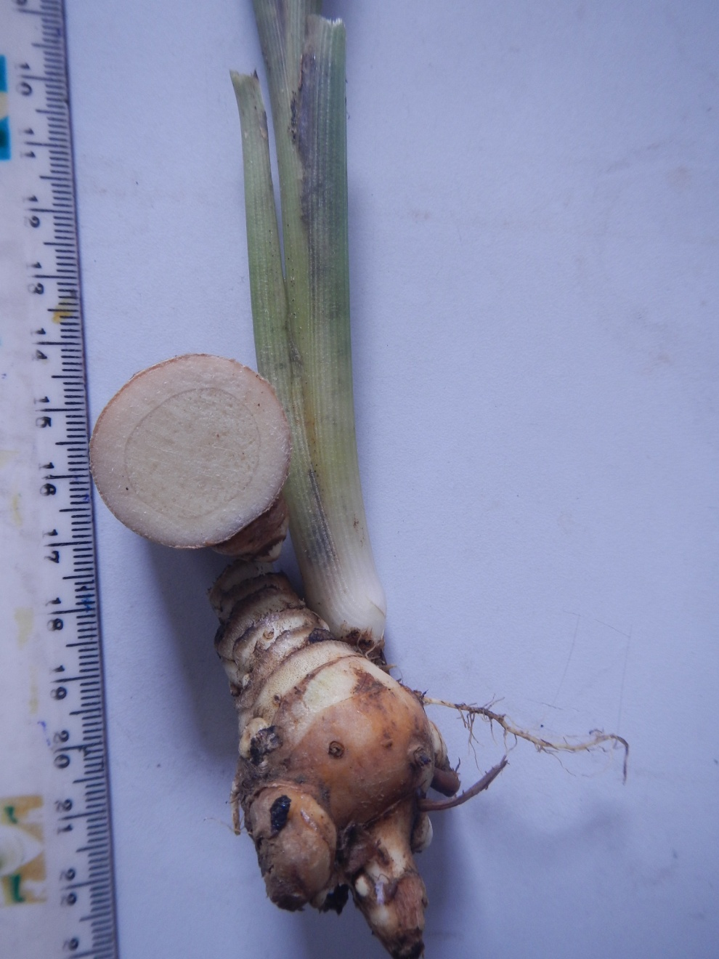
Morphology

Slide 9
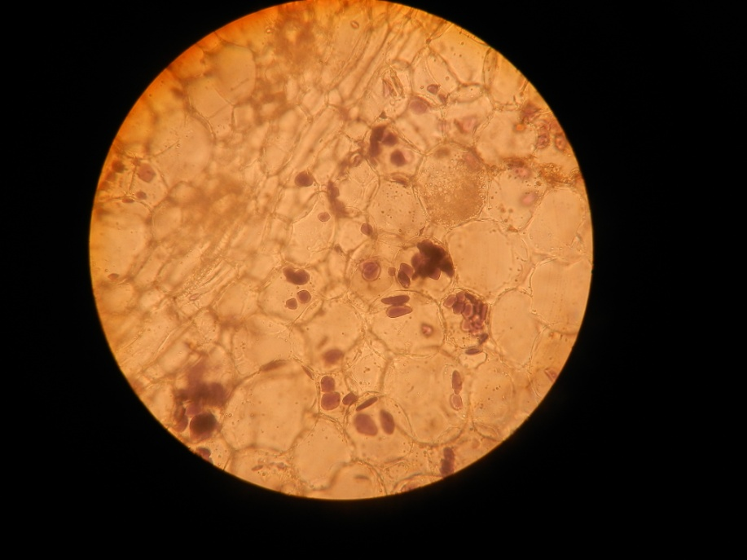
Microscopy
Industrial Technology Institute

Slide 10
Physico-chemical
Parameter | Value %
Moisture content | 13.17
Total ash | 5.74
Acid insoluble ash | 0.40
Water extractive | 38.75
70% Alcohol extractive | 21.25
Hexane extractive | 5.38
Chloroform extractive | 10.38
Industrial Technology Institute

Slide 11
Presence of Phytochemical groups
Industrial Technology Institute

Slide 12
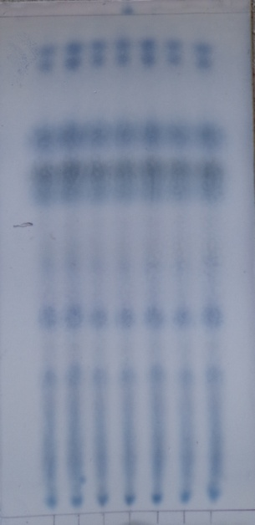
Thin Layer Chromatography
Rf value | Spot colour
0.27 | Prussian blue
0.33 | Pale pink
0.38 | Blue
0.45 | Pale pink
0.51 | Blue
0.75 | Pale pink
0.82 | Pink
0.96 | Blue
Figure: TLC fingerprint of Curcuma albiflora hexane extract, sprayed with the vanillin sulfuric acid spray reagent
Industrial Technology Institute

Slide 13
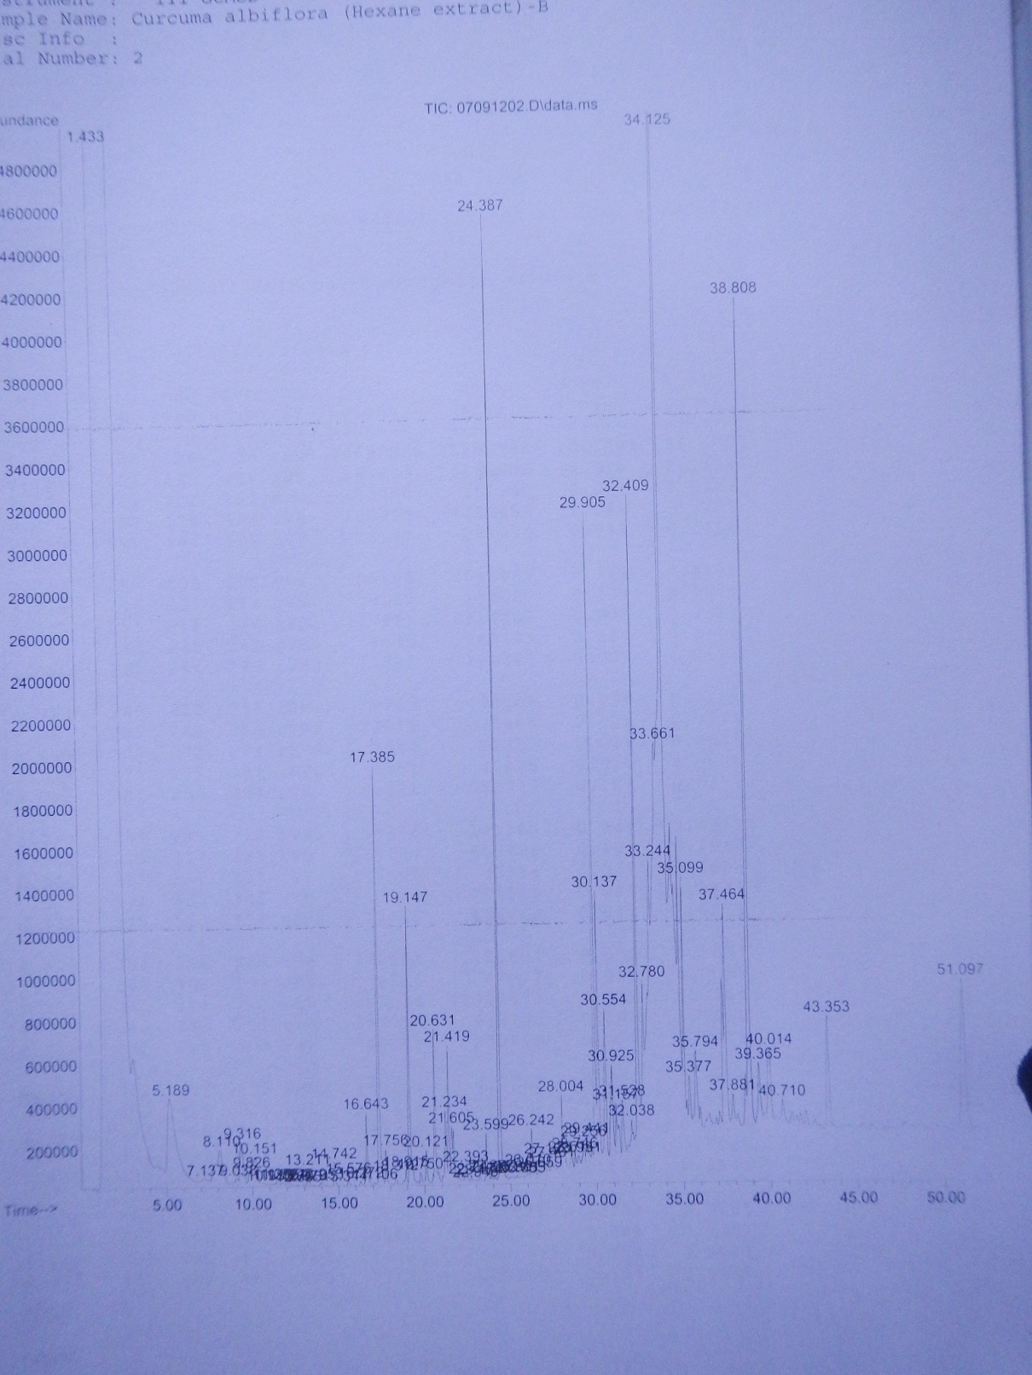
GC/MS Analysis
Figure:
Spectrum obtained for the GC/MS analysis of the n-hexane extract of Curcuma albiflora
Industrial Technology Institute

Slide 14
GC/MS Identification
Compound | Area percentage
beta-Myrcene
dl-Limonene
alpha-terpinolene
delta-Elemene
bête-Elemene
alpha-Copaene
6-Aminocaporic acid
beta-Selinene
Camphor
Industrial Technology Institute

Slide 15
Conclusions
Curcuma albiflora fresh rhizomes can be identified by its characteristic aromatic odour (Camphor like) and by the presence of black colour ring in the light yellow cortex.
Microscopically by the presence of starch grains & and essential oil filled cavities.
TLC pattern in hexane extract.
Presences of various phyto-constituents eluted by GC/MS
Camphor eluted may be used as a marker compound to identify chemically.
All in all, DNA barcode will give clear cut identity of the plant material that is yet to be completed.
Industrial Technology Institute

Slide 16
References
Wijayasiriwardena C., Premakumara G.A.S.(2012) Pharmacognostical identification of Sri Lankan endemic medicinal plant Canarium zeylanicum Blume, Annual secessions of Institute of Biology, 61.
2. Wijayasiriwardena C., Premakumara G.A.S.(2012) GC/MS Identification of essential oils of Pogostemon heynianus Benth and its adulterant Eupatorium odoratum Linn. Proceedings of International conference on chemical sciences, 143.
Industrial Technology Institute

Slide 17
THANK YOU
Acknowledge NSF Grant No: RG/2011/NRB/04
Industrial Technology Institute

