Slide 1
Unification of Electronic Health Records holistic medicine.
Sita Venkatraman and Andrew Stranieri
Centre for Informatics and Applied Optimisation, University of Ballarat, Victoria

Slide 2
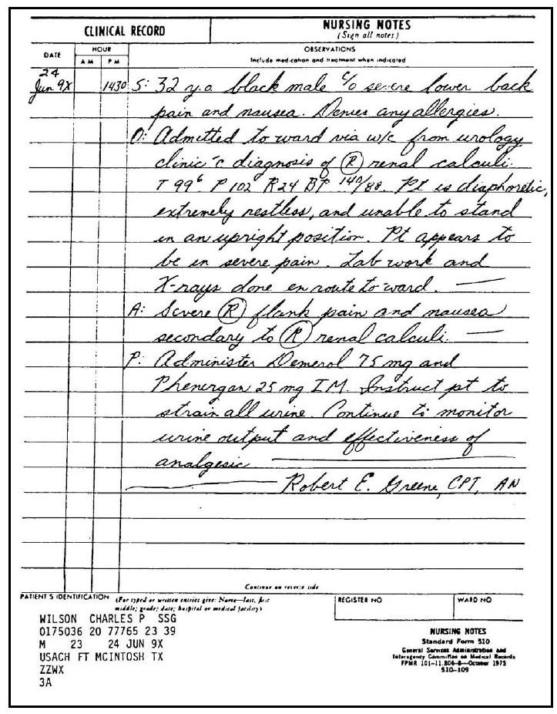
Narrative health record

Slide 3
Limitations of narrative health record
Difficult to read – leads to errors
One practitioner cannot access record of another – errors, frustrations
Longitudinal data lost – research opportunities
Common problems
Your father forgets their medication
Your daughter falls at camp and needs to go to Emergency

Slide 4
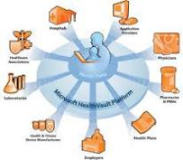
Electronic health record
A virtual electronic record of every health event from before birth to after death
Integrated so that every authorised health care professional can add to or access the record

Slide 5
Electronic health record
In Australian NEHTA. PCEHR
Microsoft Health Vault
http://www.healthvault.com/
Denmark
Bernstein 1995
US
Obama E H R by 2014

Slide 6
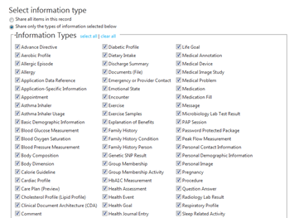
Micrsosoft Health Vault

Slide 7
Electronic health record: More complaints
Patient empowerment means more queries, complaints, disputes
Online Dispute Resolution – argument structure based organisation of the dispute to help its resolution

Slide 8
Benefits of Integration into EHR
Holistic Medicine Information. Provides all practitioners with a holistic view of patients
Improved research outcome. Interactions between phenomena discoverable. Ultimately better than clinical trials
Electronic Holistic Medicine. Provides best incentive to computerise
Standardisation of practice in Holistic medicine. Eg standard terminologies
Universal Registration of Holistic medicine practitioners
Health care practitioner acceptance
Patient empowerment. Add to their record, monitor health

Slide 9
Challenges for EHR
Privacy. Access to the record
Your employer wants access to your record
Your insurance company wants access
Your parent

Slide 10
Challenges for EHR
Privacy. Access to the record
Your employer wants access to your record
Your insurance company wants access
At what do parents no longer have access to your record

Slide 11
Ramification of EHR
More complaints, disputes between patients and practitioners
Eg. My doctor was rude. My doctor diagnosed incorrectly
Complaints not easily resolved by current dispute resolution approaches eg litigation
Experimental Approach
Online dispute resolution ReCondiser System
Hypotheses: The way disputants resolve a dispute is associated with their Emotional Intelligence

Slide 12
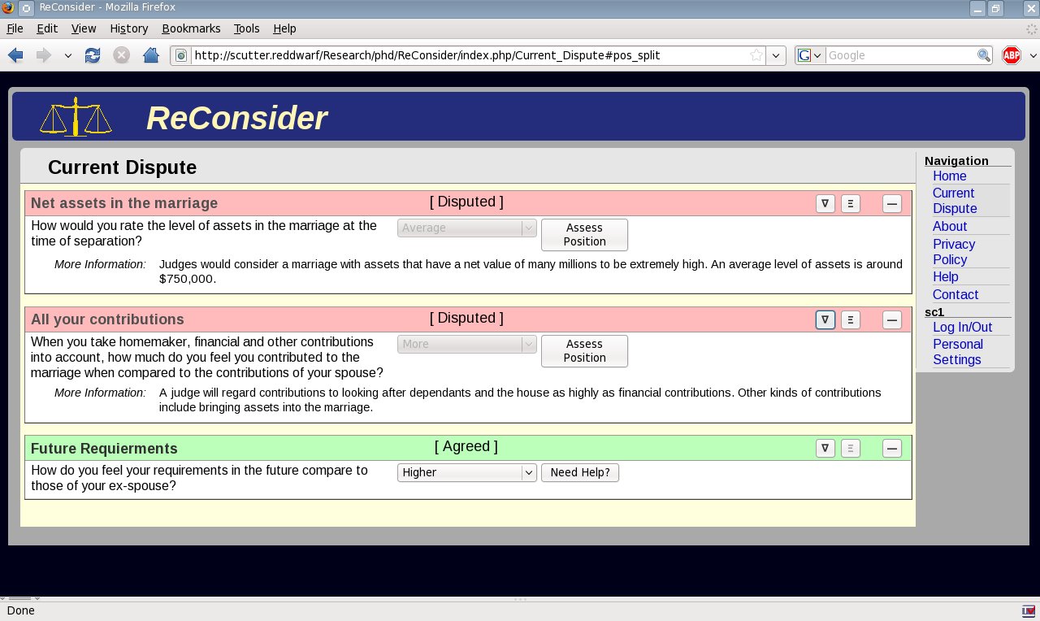
Approach
Developed Dispute resolution system

Slide 13
Approach
Two groups. Both groups EI test
Paired into doctor-patient pair
Provided a dispute scenario
Used ReConsider to resolve their dispute
Number of claim changes, time to resolve, number of items undisputed was measured
Preliminary findings indicate some association between online dispute resolution activity and EI

Slide 14
Conslusion
Many benefits for an Electronic Health Record for Holistic Medicine
Many challenges also
Some Ramifications also

